Slide 1
Introduction To Deep Learning

Slide 2
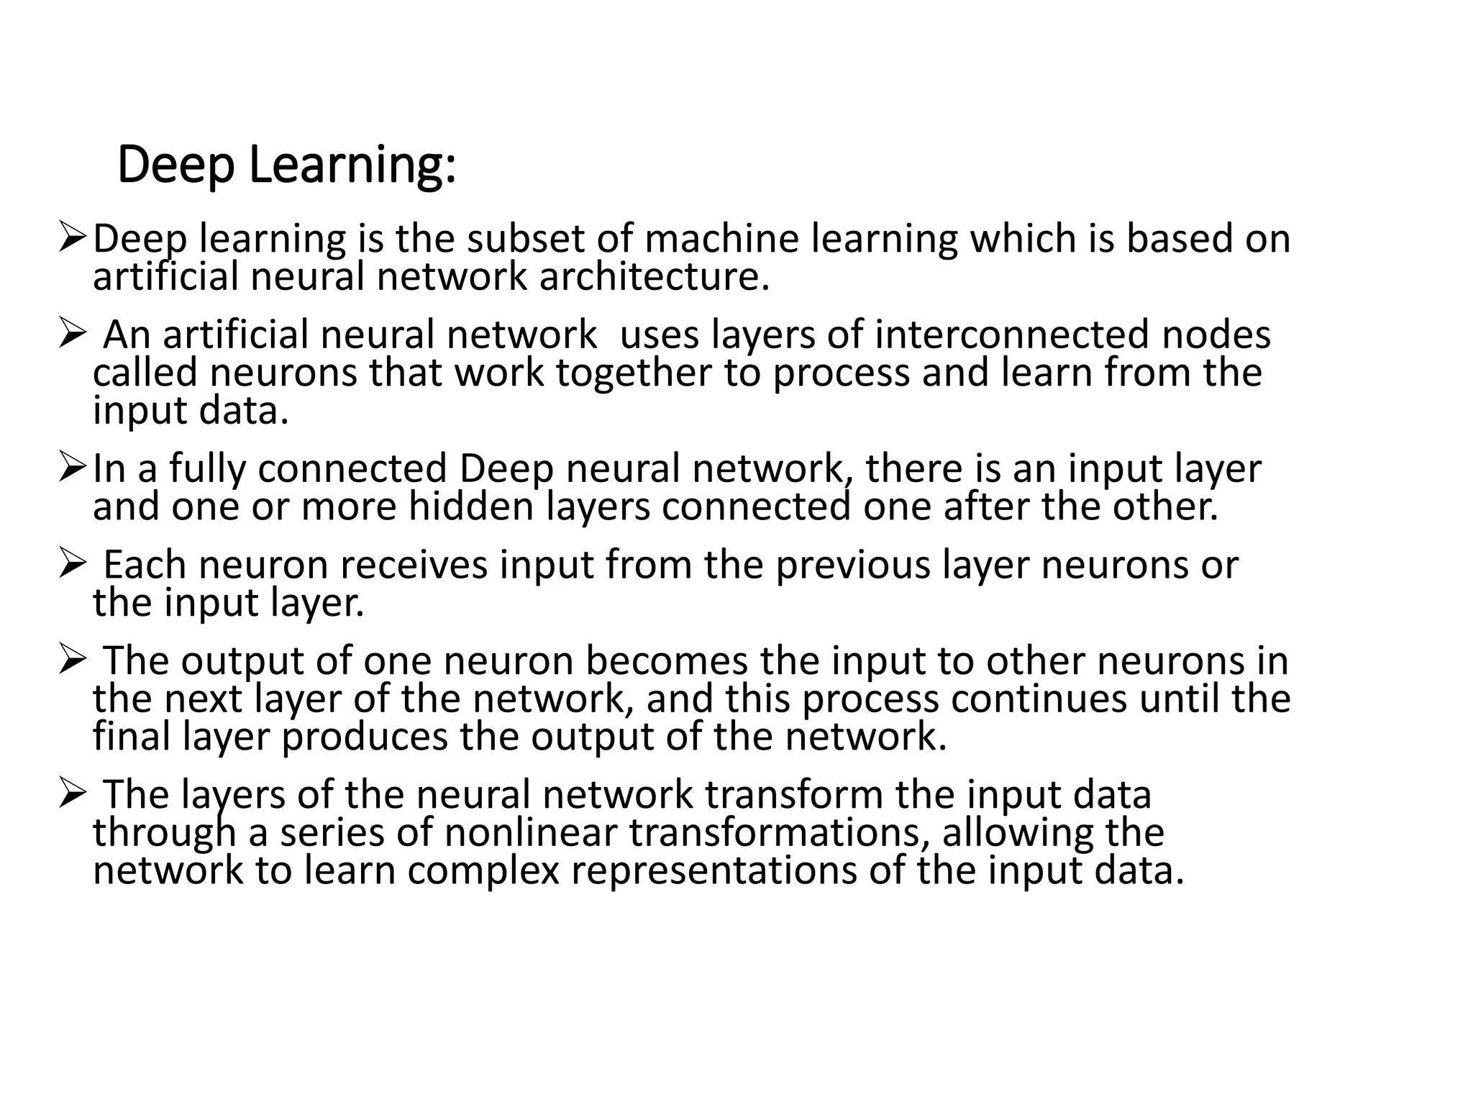

Slide 3
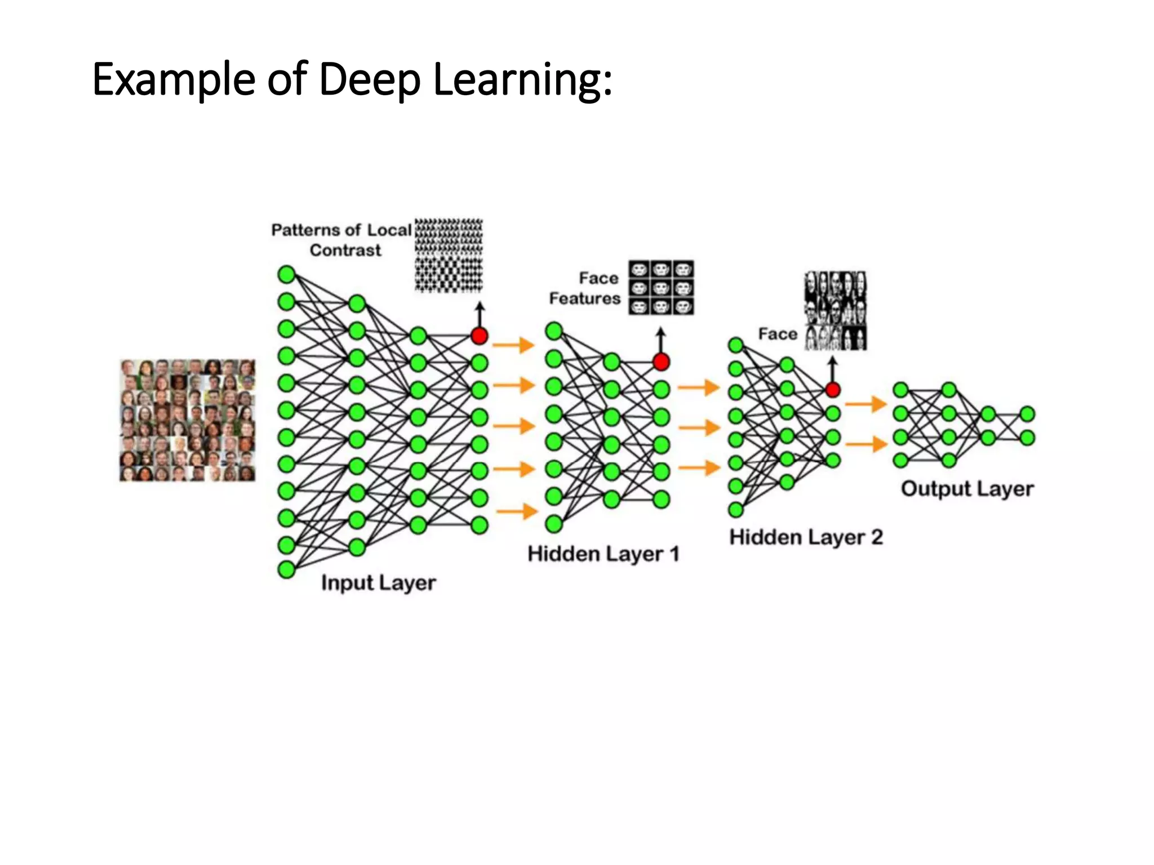

Slide 4
Types of Neural Networks
Feedforward neural networks: The most basic type of neural network, where information flows in one direction. i.e. classification, regression.
Recurrent neural networks (RNNs): Used for sequential data, such as text and time series and maintain a memory of past inputs.
Convolutional neural networks (CNNs): Specialized for processing image and video data. CNNs use convolutional layers to extract features from images, followed by pooling layers to reduce dimensionality. Image classification, object detection, image generation.
Generative adversarial networks (GANs): Used for generating new data, such as images and text. i.e. Image generation, style transfer, data augmentation.

Slide 5
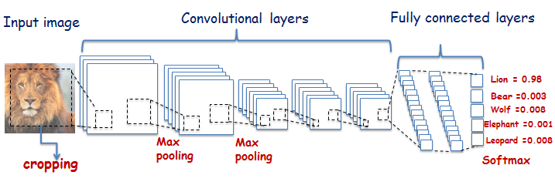
Common Deep Learning Models
Notes:
https://www.youtube.com/watch?v=fnjZG4mQ9B8&t=25s

Slide 6
Artificial Intelligence, Machine Learning and Deep Learning
Artificial Intelligence A program that can sense, reason, act and adapt
Machine Learning Algorithm whose performance improve as they are exposed to more data over time
Deep Learning Subset of machine learning in which multilayer neural networks learns from vast amount of data
Notes:
A presentation on “Relationship among AI, ML and DL”

